Slide 1
Twistlock
Ciberseguridad en el ciclo de vida de DevSecOps: VMs, Containers y Funciones serverless
Rocio Benavente Cañada
Systems Engineer

Slide 2
CYBERSECURITY FOR YOUR CLOUD NATIVE APPLICATIONS
For hosts, containers,
and serverless
Across the
DevSecOps lifecycle
Notes:
Twistlock is a comprehensive cloud native security platform, providing holistic coverage across hosts, containers, and serverless in a single platform. Regardless of how you choose to run your cloud native workloads and applications, Twistlock is there to provide unmatched defense-in-depth.
Twistlock is also integrated across the application lifecycle – at the build, at the registry, and in production. Twistlock integrates into the DevOps workflow and the tools your team already uses to provide clear, actionable security insights at every stage of the lifecycle – and to establish and enforce control gates over how an application progresses from code to build to production.

Slide 3
WHY TWISTLOCK
Started in early 2015 as the first ever purpose- built solution for containers and cloud native security
390+
Customer requested features to date
17
Major releases shipped
19+
CVEs discovered by our research team
25+
Patents issued or pending
Notes:
Twistlock was founded in early 2015 as the first ever purpose-built solution for containers and cloud native security.
We’ve have shipped 17 major releases of the Twistlock Platform.
As we look to build our product roadmap, our customers significantly influence our future development efforts
R&D is a key focus both for product and engineering and with Twistlock Labs, our security research team. They’ve disclosed over 19 CVEs to day with over 25 patents issues or pending.

Slide 4
WHY TWISTLOCK
Automation
Visibility
Prevention
VULNERABILITY MANAGEMENT
COMPLIANCE
CLOUD NATIVE FIREWALLING
RUN TIME DEFENSE
ACCESS CONTROL
CI/CD INTEGRATION
Notes:
Twistlock provides Automation, Visibility, and Prevention to protect your cloud native applications wherever they run.
Everything Twistlock offers aligns to these central pillars:
Twistlock automates the creation of policy, scaling to protect the your production environments.
Twistlock provides powerful visibility, so you can see exactly how your environment is running in real time.
Finally, Twistlock can actually prevent bad actions from happening with unmatched defense-in-depth--combining 4D models of application behavior with layer 4 and layer 7 firewalls.
Our features, which I will cover later in the presentation, span the entire application lifecycle.

Slide 5
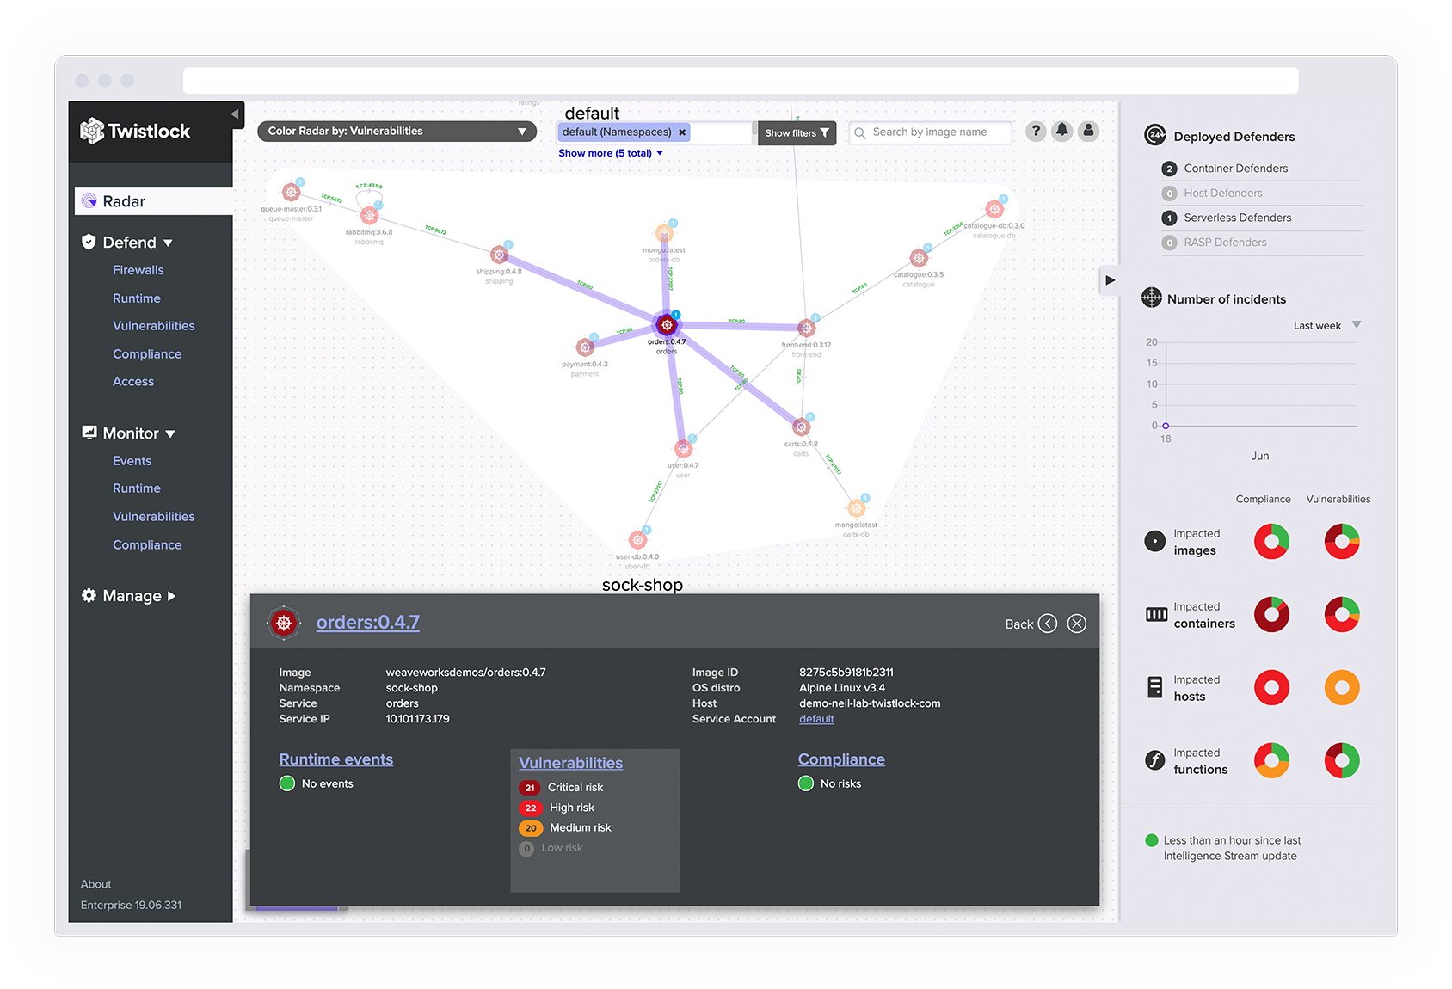
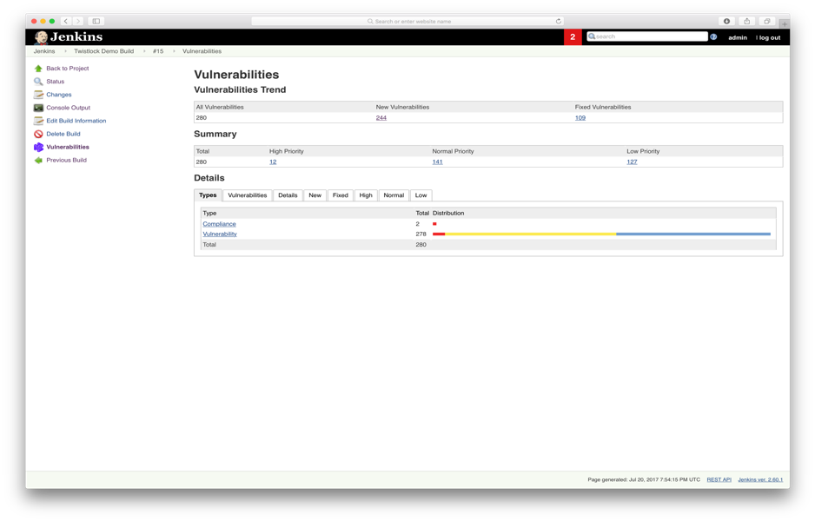
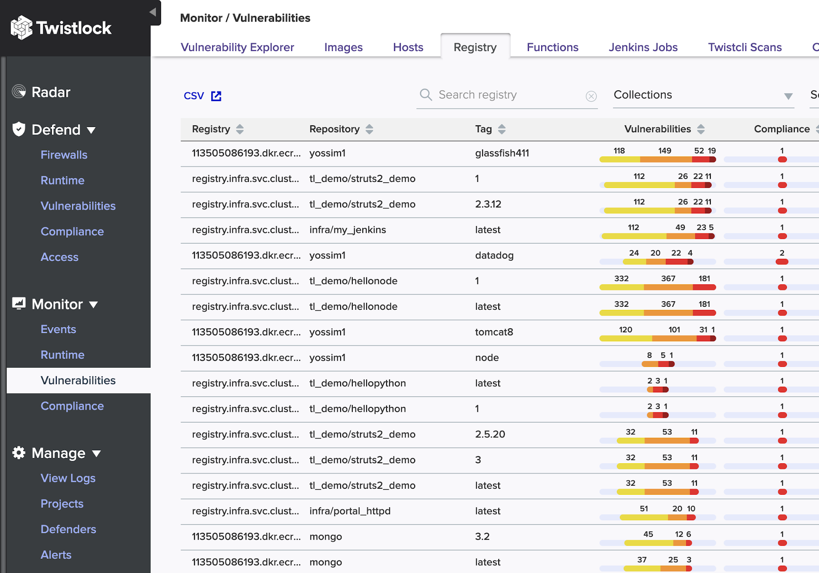
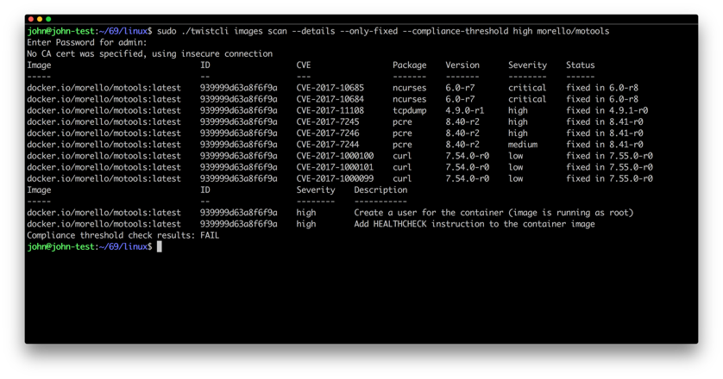
ARCHITECTURE
Console
API
IAM
Intelligence Stream
Alerting
Defenders
CI/CD
Registries & Repos
container runtime
host OS
host OS
serverless / PaaS
metal / VM / laaS
metal / VM / laaS
cloud provider
Notes:
The Twistlock Intelligence Stream is comprised of over 30 distinct threat intelligence feeds to provide you with accurate, up-to-date vulnerability information about your environment. This data is ingested by the Twistlock Console, our dashboard which runs as a container within your environment.
Defenders protect your containerized environment according to the policies you set in Console. In the Architecture diagram, we also highlight our CI integrations, either through our native Jenkins plugin or through twistcli, our command line scanner.
Additionally, you’ll notice that Twistlock is entirely-API driven – so you can access data within any data analytics or SIEM of your choosing – and integrate Twistlock with any identity and access management frameworks you are using at your organization.

Slide 6
Vulnerability Management
Automation Visibility Prevention
Industry leading precision across hosts, images, containers, and serverless functions
Automated prioritization of vulnerabilities based on your unique environment
Prevent running vulnerable software across your environment
Notes:
Twistlock delivers industry-leading precision. We curate over 30 distinct vulnerability feeds to deliver to customers the lowest possible false positive rate. This accuracy provides everyone, including developers, devops teams, and security teams, with confidence in scanning results.
To improve risk prioritization, Twistlock automatically generates a risk score for every detected CVE in your environment – a risk score based on the nature of the vulnerability, as well as how your applications are deployed and running. By tailoring this prioritization to your specific environment – teams can focus on remediation for the most important risks first.
Twistlock offers vulnerability management for includes hosts, containers and images, container registries, serverless repositories, and PCF blobstores.

Slide 7
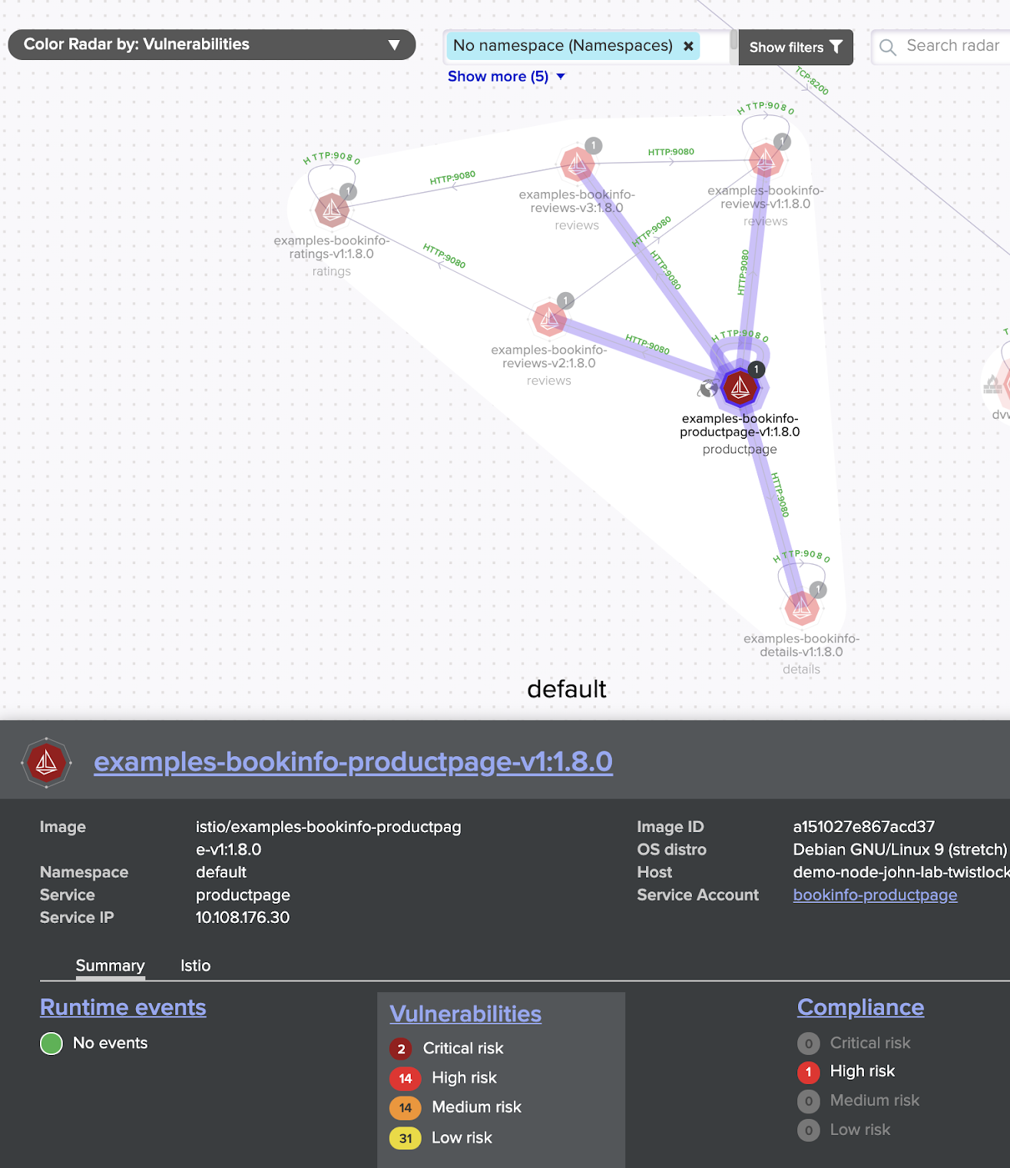
Cloud Native Firewalling
Automation Visibility Prevention
Layer 4 and Layer 7 firewalls tuned for cloud native environments
True Intrusion Detection and Intrusion Prevention
Fully automated mesh discovery and microsegmentation
Notes:
Twistlock enables organizations to embrace a hybrid cloud strategy and leverage a diverse group of compute options for running their apps with powerful features for securing their networks.
Twistlock provides unmatched network protection across the cloud native continuum with layer 4 and layer 7 firewalls that are container aware and integrate seamlessly with dynamically orchestrated environments. Instead of being bound to static IP endpoints – the protection from these firewalls follows your applications – no matter how your environment shifts – again – without user intervention to make configuration changes.

Slide 8
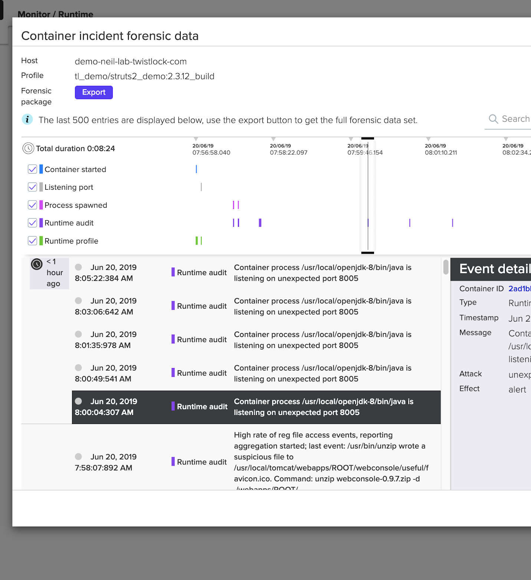
Runtime Defense
Automation Visibility Prevention
Automatic modeling of explicit ‘allow lists’ every app
Automated incident detection and prevention based on model and threat indicators
Continuous forensics for every container and host in your environment
Notes:
As I mentioned earlier, Twistlock offers the ability to provide both automatic policy creation and defense-in-depth. Runtime defense automatically creates 4D behavioral models of every individual application to alert on or prevent anomalous activity or attacks from occurring.
Responding to security incidents in a cloud native environment represents a challenge for traditional security organizations and incident responders – Twistlock Incident Explorer surfaces the attacker kill chain including forensics data with every security incident. This ‘flight data recorder’ enables security teams and incident responders to assess configuration and vulnerability risks, and triage how an incident fits into your larger environment.

Slide 9
Runtime Defense
STOPPING THE KILL CHAIN
Automation Visibility Prevention
syscall sensors detect anomalous kernel calls
buffer = OPENSSL_malloc(1 + 2 + payload + padding);bp = buffer;
App
vulnerable web service
Docker Engine
nc –l –p 666
App
network sensors detect abnormal traffic flows and dangerous endpoints
Docker Engine
storage sensors looks for malware and suspicious file access patterns
App
Docker Engine
process sensors see a process not in the authentic image and stop it from spawning
App
Docker Engine
Notes:
As I mentioned earlier, Twistlock offers the ability to provide both automatic policy creation and defense-in-depth. Runtime defense automatically creates 4D behavioral models of every individual application to alert on or prevent anomalous activity or attacks from occurring.
Responding to security incidents in a cloud native environment represents a challenge for traditional security organizations and incident responders – Twistlock Incident Explorer surfaces the attacker kill chain including forensics data with every security incident. This ‘flight data recorder’ enables security teams and incident responders to assess configuration and vulnerability risks, and triage how an incident fits into your larger environment.

Slide 10
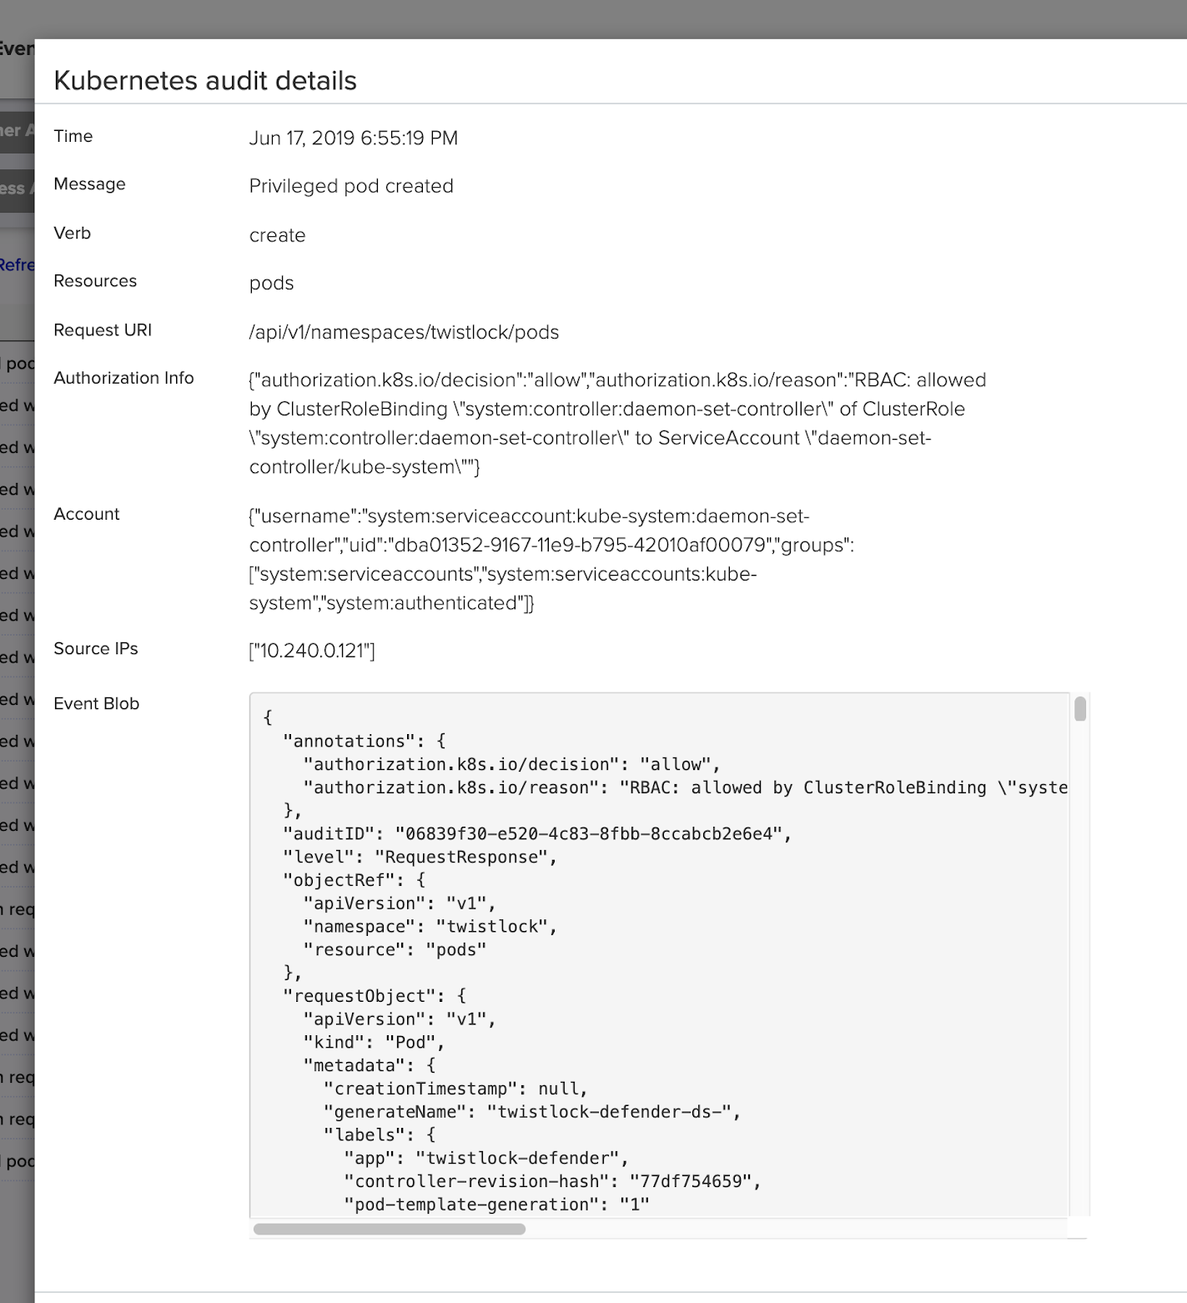
Access Control
Automation Visibility Prevention
Enterprise-grade file integrity monitoring, host auditing, and log file inspection
Secrets management integrated with all popular providers
Central monitoring of docker, sshd, and sudo events
Real time stream processing of Kubernetes AuditSink
Notes:
Twistlock allows you to establish and monitor proper access control measures for cloud workloads and cloud native applications. Enterprises leverage Twistlock across the cloud native stack to protect their underlying hosts, Docker, and Kubernetes while integrating with IAM and secrets management tools along with other core technologies.
We provide powerful features for protecting standalone VMs, including file integrity monitoring, log inspection, host forensics, and custom runtime rule language that also applies to containers.

Slide 11
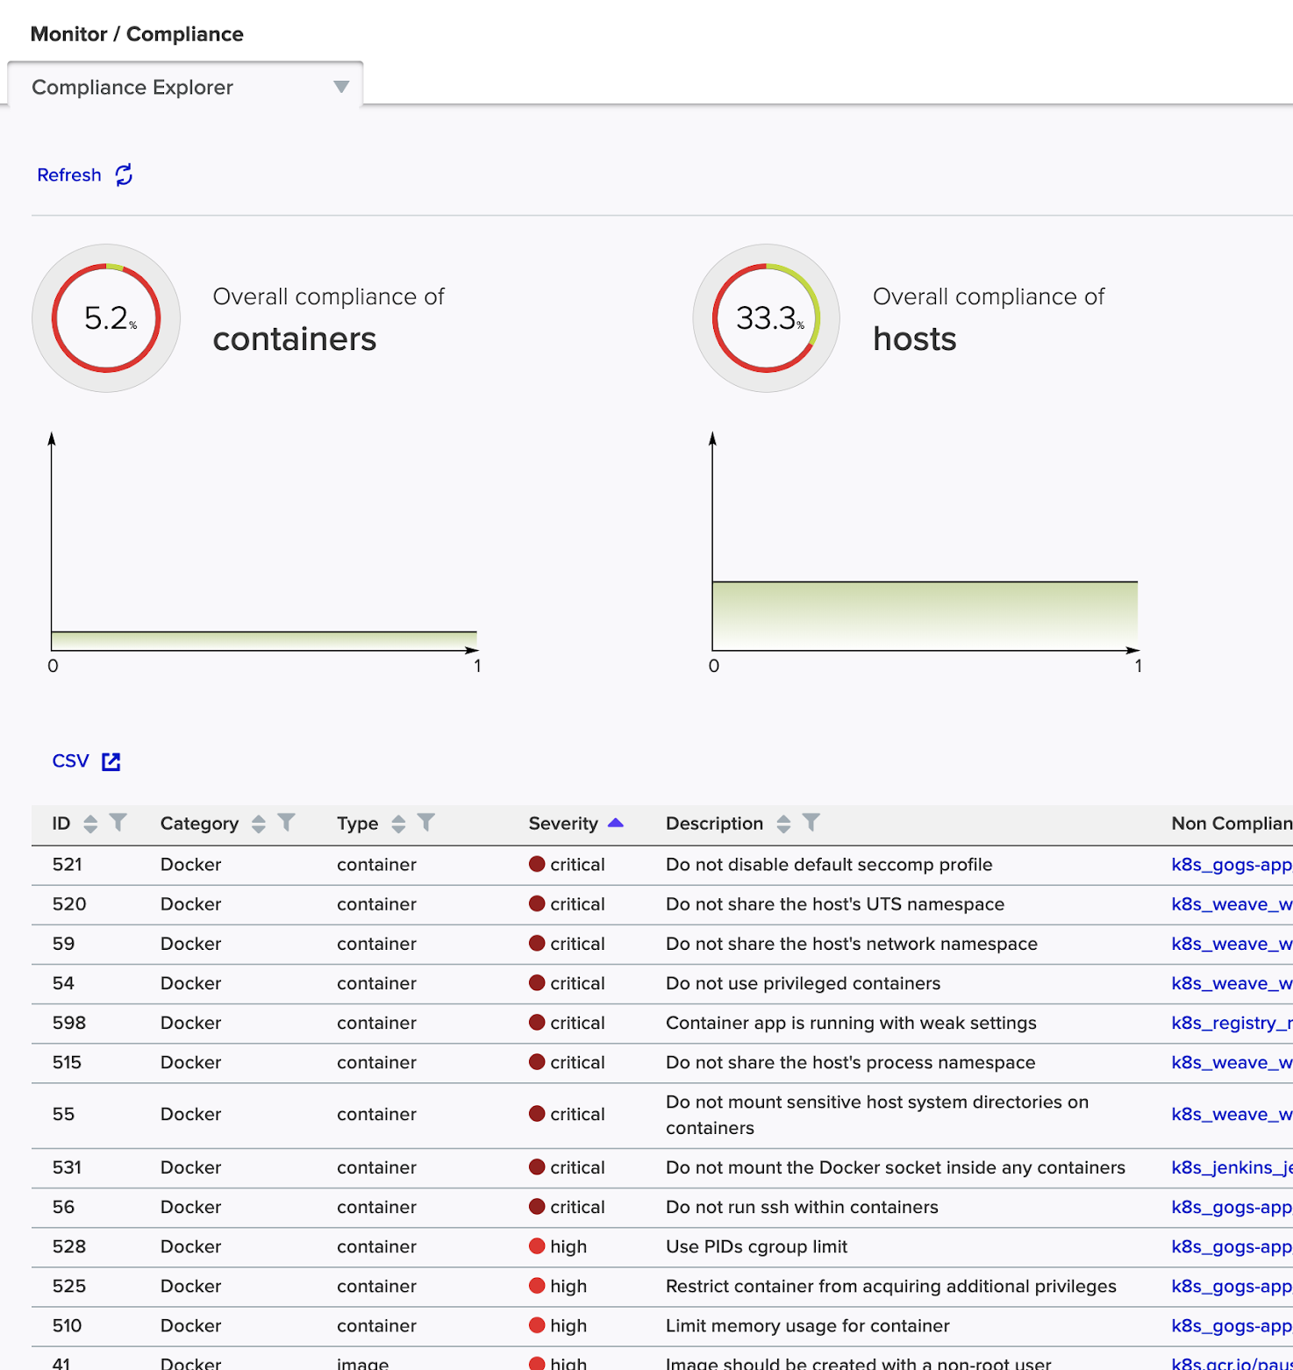
Compliance
Automation Visibility Prevention
One-click enforcement for CIS, PCI-DSS, HIPAA, GDPR, NIST SP 800-190, and FISMA
Centrally discover and monitor cloud native services across all your providers, accounts, and regions
Custom checks using OpenSCAP, PowerShell, and Bash scripts
Notes:
We mentioned earlier our authorship of the NIST SP on container security – additionally, Twistlock also provides pre-build templates for notable external compliance regimes. In less than a minute, you can apply the NIST recommendations to your environment or any portion of it – the same is true with GDPR, PCI DSS and HIPAA.
These templates are only a subset of Twistlock’s comprehensive compliance controls, with full support for the AWS, Docker, Kubernetes and Linux CIS benchmarks, and a centralized compliance dashboard that provides audit teams with a single pane of glass to inspect current and historical compliance across all elements of your cloud native environment.

Slide 12
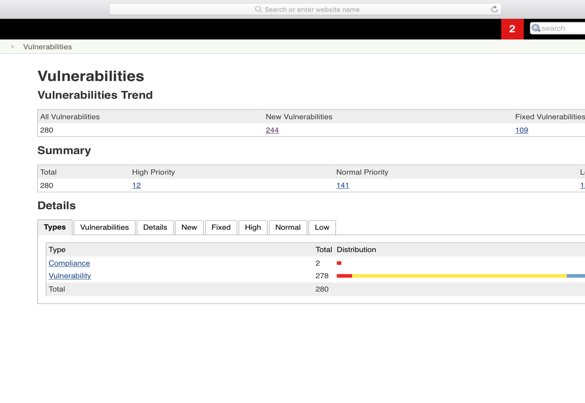
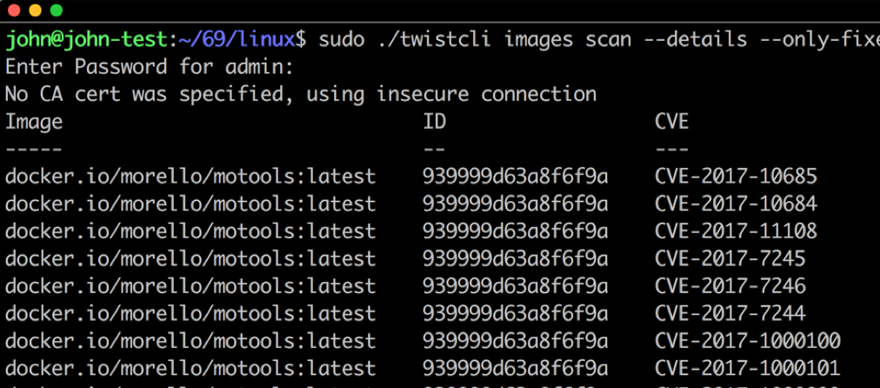
CI/CD Integration
Automation Visibility Prevention
Native plugins and standalone scanner for integration into any CI/CD workflow or tool
“Shift left” quality gates with compliance and vulnerability thresholds in every build
Scan hosts, container images, serverless functions, and PCF blob stores
Notes:
It’s our belief that security shouldn’t be an operational burden. Traditional security tools, and a lot of other container security solutions as well, often require developers to step out of their toolchain to see the security posture of applications they’re building. With Twistlock, our goal is to meet developers where they already are.
We have a native Jenkins plugin and a standalone command line scanner that works with any CI/CD tool – to deliver vulnerability and compliance scan results directly to developers; without requiring them to leave the tools they already use. In addition to this visibility, Twistlock can block or fail builds that exceed user-defined thresholds – so you can prevent risky or non-compliant applications from reaching sensitive environments.

Slide 13
FULL LIFECYCLE SECURITY
Build
Ship
Run
Integrate Twistlock with any CI tool you are using to provide vulnerability and compliance scanning and enforcement for your container images, hosts, and serverless functions.
Continuously monitor your registry to ensure you are always shipping secure code into production.
Protect your running applications with cloud native firewalls, powerful runtime defense, and access control — providing defense in depth to prevent next generation attacks.

Slide 15
Thank You
paloaltonetworks.com
Email: rbenavente@paloaltonetworks.com

